Slide 1
Stability analysis of grid interactive wind energy system – A case study

Slide 2

A Project On
STABILITY ANALYSIS OF GRID INTERACTIVE WIND ENERGY SYSTEM – A CASE STUDY ON HARAPANAHALLI WIND FORM
BACHELOR OF ENGINEERING
DEPARTMENT OF ELECTRICAL AND ELECTRONICS ENGINEERING
Submitted by :
NAME | USN No.
SHASHIDHARA K M | 4JD17EE422
MANOHARA M C | 4JD17EE411
MALATESH KUMAR K P | 4JD17EE409
MOHAMAD ZABIULLA K | 4JD17EE412
Under the guidance of
Mrs. Shailaja B M
Asst . Professor, Dept. of EEE
JIT, DVG
Jain Institute of Technology
Academic Year 2019-2020

Slide 3
CONTENTS
Introduction
about A case study – Wind Power plant
Literature Survey
Description on Project
Why Double Fed Induction Generator
Static Synchronous compensator(STATCOM)
Simulation Model of DFIG
Objectives met by STATCOM
Final summary

Slide 4
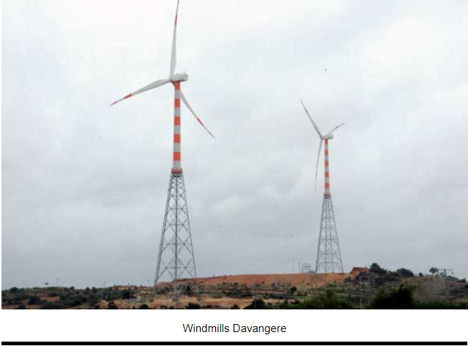
Introduction on Project
Importance of Wind Power Generation on Future
Why Stability is important ?
The role of Reactive Power on grid

Slide 5
About A Case Study – Wind Power Plant
HARAPANAHALLI
ANANTHANAHALLI
Project Name | : | Green Infra Wind Solutions Limited.
Technology | : | Geared Wind Turbine(18)
Capacity | : | 36 MW.
Commissioning | : | February 2011
Customer | : | Bangalore Electricity Supply Company Limited
Project Name | : | Green Infra Wind Solutions Limited.
Technology | : | Geared Wind Turbine(22)
Capacity | : | 48 MW
Commissioning | : | 2017
Customer | : | Bangalore Electricity Supply Company Limited

Slide 6
Literature Survey
“Impact of DFIG based Wind Energy Conversion System on Fault Studies and Power Swings” – by K Shanti Swarup ,EE Dept. IITM
“Reactive Power Capability of the Wind Turbine with Doubly Fed Induction Generator” – by B. Rabelo IEEE paper
“Voltage Stability and Power Quality Issues of Wind Farm with Series Compensation” – by T. F. Orchi, Student Member IEEE
“A STATCOM-Control Scheme for Grid Connected Wind Energy System for Power Quality Improvement” –by Sharad W. Mohon Member IEEE
“Mitigating Voltage Sag by Implementing STATCOM on DFIG-based Wind Farms Connected to a Power System” – by M. J. Ghorbanifar, F. Goodarzv International Conference on Engineering Technology

Slide 7
Description of Project
What are the Problem Facing by wind power plant ?
What are the Solution to over come it ?
What methods (METHODOLOGY) are using in Project ?

Slide 8
Why Double Fed Induction Generator
Why not Induction Generator or Synchronous generator ?
Because of these 5 reasons –
Constant frequency output signal to the grid irrespective of the variable rotor speed.
Low power rating required for the power electronic devices and hence low cost of control system.
Power factor is controlled, i.e. maintained at unity.
Electric power generation at low wind speed.
Power electronic converter has to handle the fraction of the total load i.e.,20-30% and also cost of this converter is low than in case of the other types of generators

Slide 9
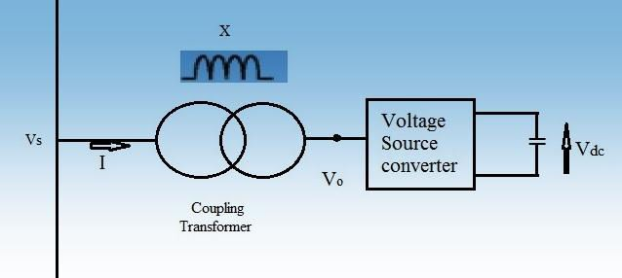
Static Synchronous compensator(STATCOM)
The STATCOM is a shunt device that uses power electronics to control power flow and improve transient stability on power system grids.
STATCOM is a reactive power compensators based on Voltage Source Converter.
The major advantages are :
cost of investment
cost of operation
low maintenance
Fig. Schematic representation of STATCOM

Slide 10
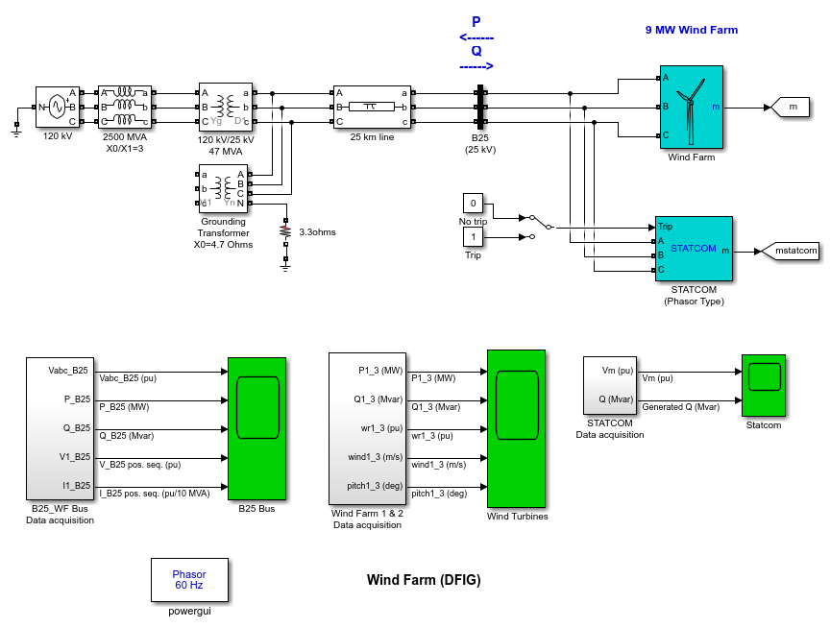
Simulation Model of DFIG
Fig. Simulink model of DFIG wind energy system with STATCOM

Slide 11
Objectives met by using STATCOM controller are :
The voltage waveform and reactive power at the bus shows an improvement
The Power, rotor speed, pitch angle and reactive power, shows an improvement in the Stability.
The Performance of different operating conditions shows the improvement in the Voltage and generated reactive power.

Slide 12
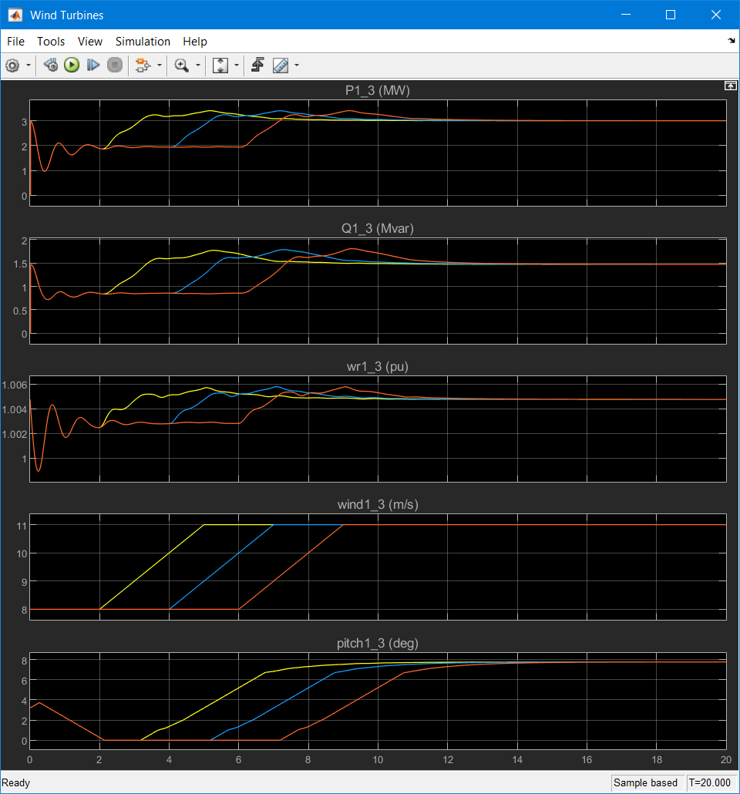
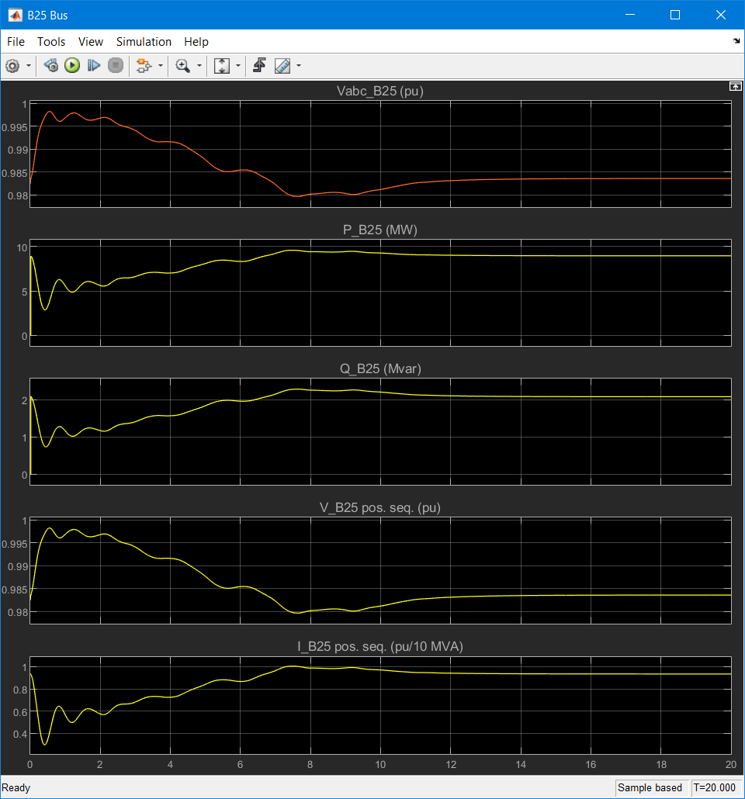
Wave form results for with STATCOM Wind Plant
Fig 1a. Wind Turbine Wave form of DFIG wind energy system with STATCOM
Fig 1b. Bus wave form of DFIG wind energy system with STATCOM

Slide 13
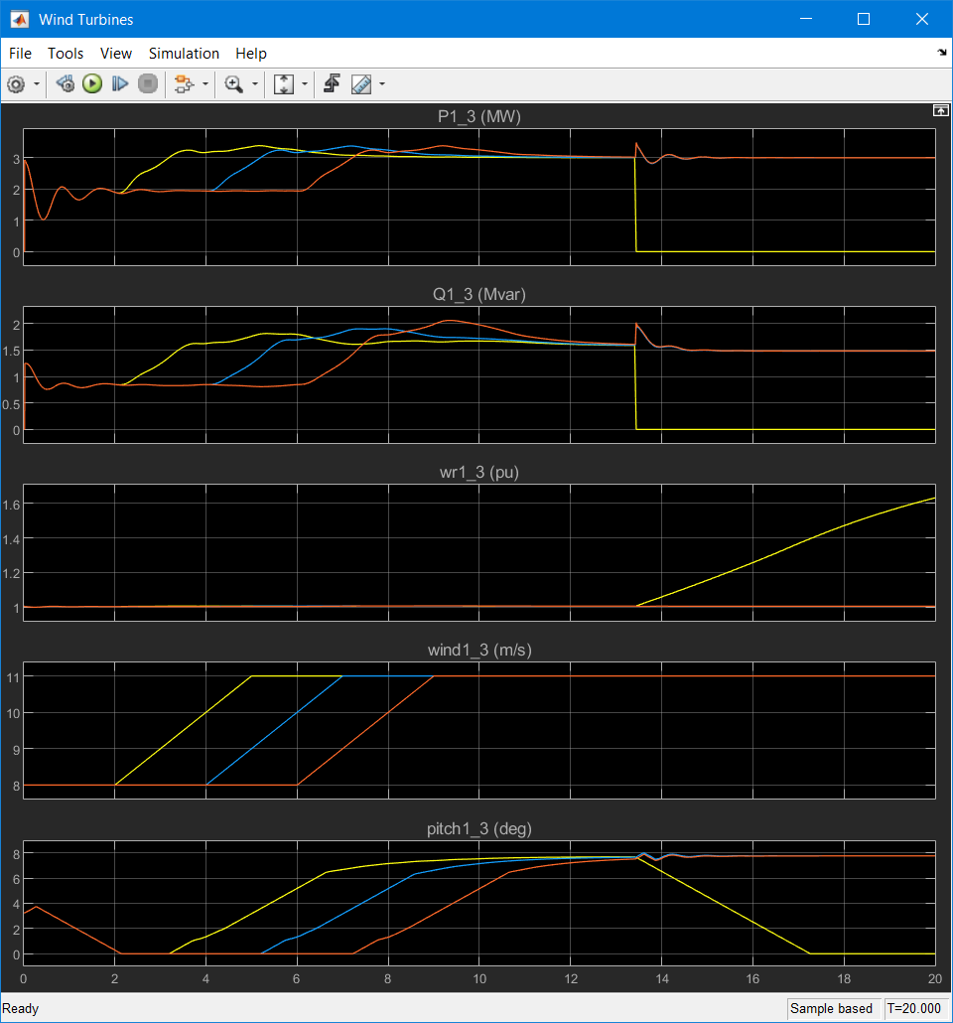
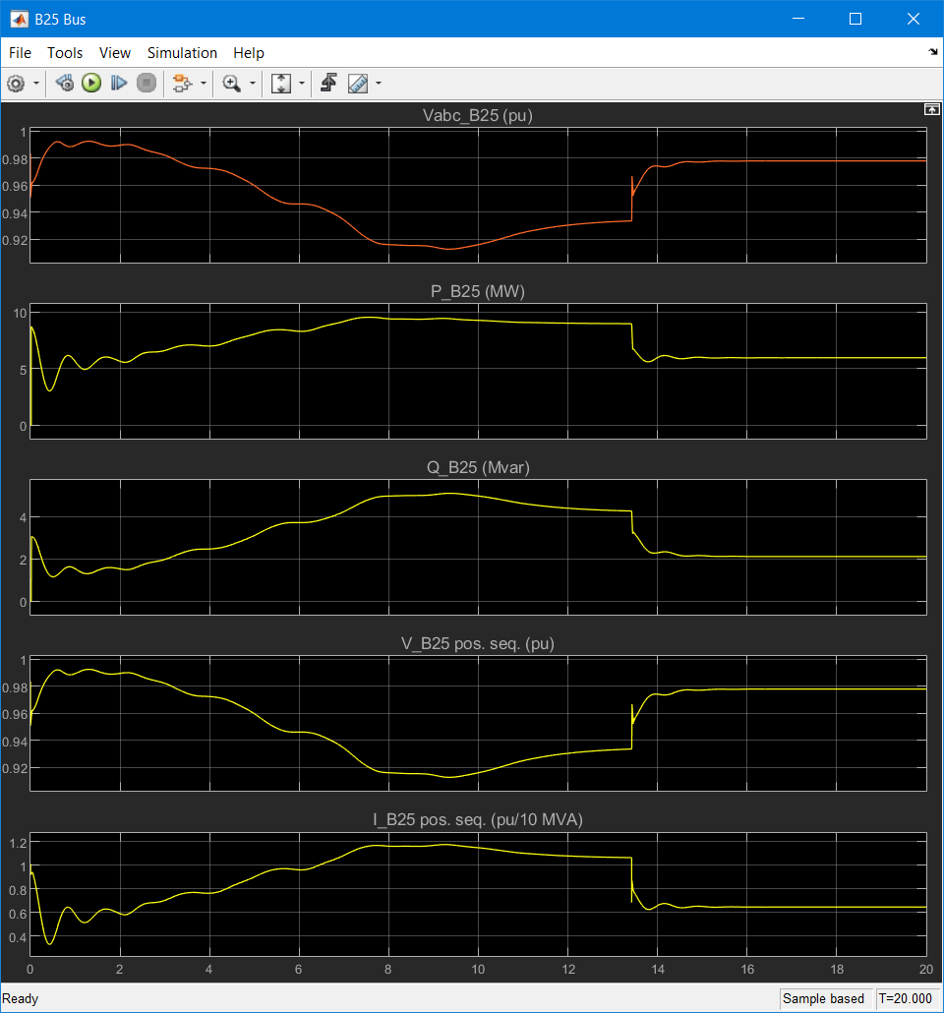
Wave form results for without STATCOM Wind Plant
Fig 2a. Wind Turbine wave form of DFIG wind energy system without STATCOM
Fig 2b. Bus wave form of DFIG wind energy system without STATCOM

Slide 14
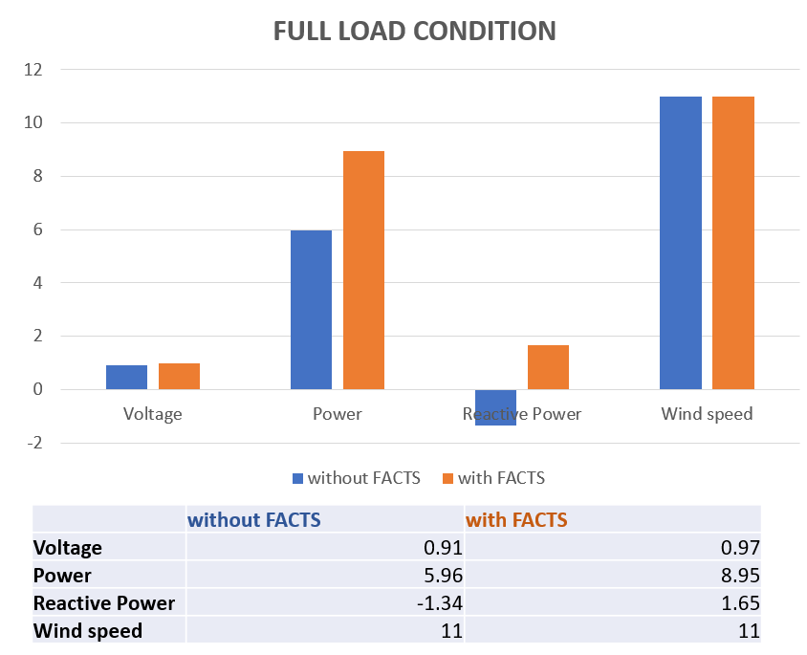
Final Summary
The results obtained from simulation shows that of the compensation methods of STATCOM is more effective in providing reactive power support, improving voltage profile and improving the system stability.
The study results encourage to use STATCOM in wind energy systems for effective reactive management, improved voltage profile and better stability of the system meeting the grid requirements for connecting it with the grid.
Fig. Comparisons of parameters with and without FACTS

Slide 15
REFERENCE
Narain G. Hingorani, Laszlo Gyugi. “Understanding FACTS- Concepts and Technology of AC Transmission Systems.” IEEE Press
Adriano Abrantes, “Overview of Power Quality Aspects in Wind Generation”
J. Tian, Student member IEEE, C. Su, Member, IEEE, and Z. Chen, Senior member, IEEE, “Reactive Power Capability of the Wind Turbine with Doubly Fed Induction Generator”
Touraj Tayyebifar, Mohammad Shaker, Majid Aghababaie, “Performance Comparison of STATCOM versus SVC to Improve Reactive Power Control in Wind Power Based DFIG under Short Circuit Fault”, 2014 Ninth International Conference on Ecological Vehicles and Renewable Energies(EVER)
K. R. Padiyar, A. M. Kulkarni. “Flexible AC Transmission System: A status review.”

Slide 16
THANK YOU

